Slide 1
Analysis of Variance
Chapter 12

Slide 2
ANOVA Assumptions:
Normality
the values in each of the groups (as a population) follow the normal curve
Independence
the values in each of the groups do not depend on one another
Homogeneity
the values in each of the groups (as a population) have the same variance

Slide 3
Why study variance?
Population variances are often used in quality control studies to measure the variability of the weight, size, or volume of a product.
Example: a bottler who wishes its production line to fill a certain amount of beverage amount, but also to keep the variability amount filled below some tolerance limit.
Example: with variance used as a quantitative measure of risk, an investor may want to evaluate his/her risk in a particular investment.

Slide 4
Analysis of Variance: A Conceptual Overview
Analysis of Variance (ANOVA) can be used to test
for the equality of three or more population means.
Data obtained from observational or experimental
studies can be used for the analysis.
We want to use the sample results to test the
following hypotheses:
H₀: μ₁ = μ₂ = μ₃ = . . . = μ_{k}
H_{a}: At least two of μ_{1,} μ_{2, …..} μ_{k} differ

Slide 5
Analysis of Variance: A Conceptual Overview
H₀: μ₁ = μ₂ = μ₃ = . . . = μ_{k}
H_{a}: At least two of μ_{1,} μ_{2, …..} μ_{k} differ
If H₀ is rejected, we cannot conclude that all
population means are different.
Rejecting H₀ means that at least two population
means have different values.

Slide 6
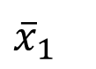
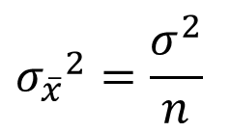
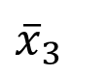
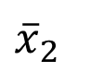
Analysis of Variance: A Conceptual Overview
Sampling Distribution of $\overline{x}$ Given H₀ is True
Sample means are close together
because there is only
one sampling distribution
when H₀ is true.
$${σ_{\overline{x}}}^{2}=\frac{σ^{2}}{n}$$
$${\overline{x}}_{2}$$
μ
$${\overline{x}}_{1}$$
$${\overline{x}}_{3}$$

Slide 7
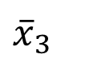
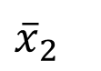
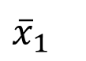
Analysis of Variance: A Conceptual Overview
Sampling Distribution of $\overline{x}$ Given H₀ is False
Sample means come from
different sampling distributions
and are not as close together
when H₀ is false.
$${\overline{x}}_{3}$$
μ₃
$${\overline{x}}_{1}$$
μ₁
μ₂
$${\overline{x}}_{2}$$

Slide 8
Example:
Suppose you are a manager and you have 4 groups of employees based on previous work experience:
Group 1: < 3 years
Group 2: 3-5 years
Group 3: 5-10 years
Group 4: > 10 years

Slide 9
Example 1a: Salaries of Employees in each Group (n=40)
Group 1 | Group 2 | Group 3 | Group 4
$39,142 | $58,319 | $81,955 | $82,940
$39,388 | $61,029 | $81,786 | $86,546
$41,929 | $61,513 | $78,887 | $91,407
$43,834 | $57,372 | $86,108 | $77,838
$34,662 | $58,282 | $74,714 | $109,550
$43,255 | $62,119 | $76,732 | $105,983
$35,921 | $66,749 | $77,024 | $114,159
$36,135 | $60,632 | $85,409 | $108,117
$37,676 | $61,425 | $71,161 | $108,746
$40,700 | $56,612 | $83,441 | $87,706

Slide 10
Process
Are the mean salaries in these four groups (µ₁, µ₂, µ₃ and µ₄) different from one another?
H₀: µ₁ = µ₂ = µ₃ ₌ µ₄
H_{a}: at least one of µ₁, µ₂, µ₃, µ₄ differs
*sorry! This alternative hypothesis deviates from what is in your textbook—honestly it’s the most often used alternative hypothesis and I made up the example with what I’m used to.

Slide 11
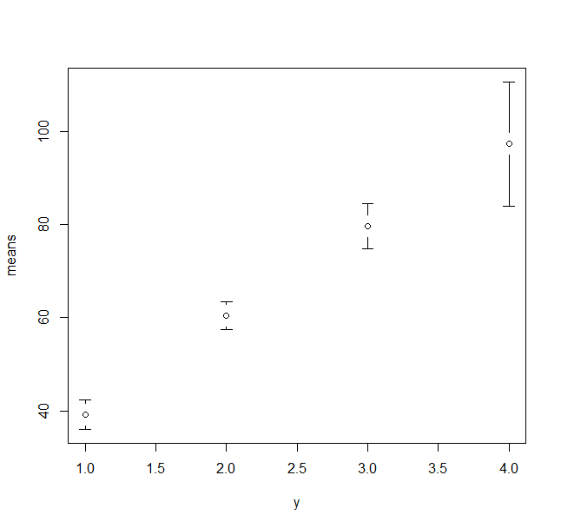
Example 1a:
Salary in 1000s
Group 1
Group 2
Group 3
Group 4

Slide 12
ANOVA
Variance between groups
Variance among groups

Slide 13
ANOVA: Example 1a
Group 1 | Group 2 | Group 3 | Group 4
$39,142 | $58,319 | $81,955 | $82,940
$39,388 | $61,029 | $81,786 | $86,546
$41,929 | $61,513 | $78,887 | $91,407
$43,834 | $57,372 | $86,108 | $77,838
$34,662 | $58,282 | $74,714 | $109,550
$43,255 | $62,119 | $76,732 | $105,983
$35,921 | $66,749 | $77,024 | $114,159
$36,135 | $60,632 | $85,409 | $108,117
$37,676 | $61,425 | $71,161 | $108,746
$40,700 | $56,612 | $83,441 | $87,706
$39,264 | $60,405 | $79,722 | $97,299
Mean μ
H₀: µ₁ = µ₂ = µ₃ ₌ µ₄

Slide 14
ANOVA Example 1a:

Slide 15
ANOVA Example 1a:
Where:
p: is the # of populations (4)
n_{i} : sample size of the ith population (10)
Variance Between Groups : SST

Slide 16
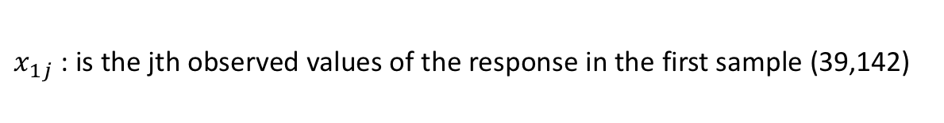
ANOVA Example 1a:
Variance within Groups
Where:
$x_{1j}$ : is the jth observed values of the response in the first sample (39,142)

Slide 17
ANOVA Example 1a:

Slide 18
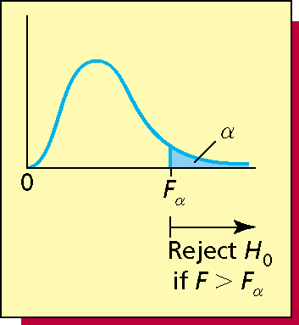
ANOVA Example 1a:
F Statistic = MST / MSE
α=0.05
F_{α}=2.86 (F table)
F=114.4
Reject H₀ at 95% confidence

Slide 19
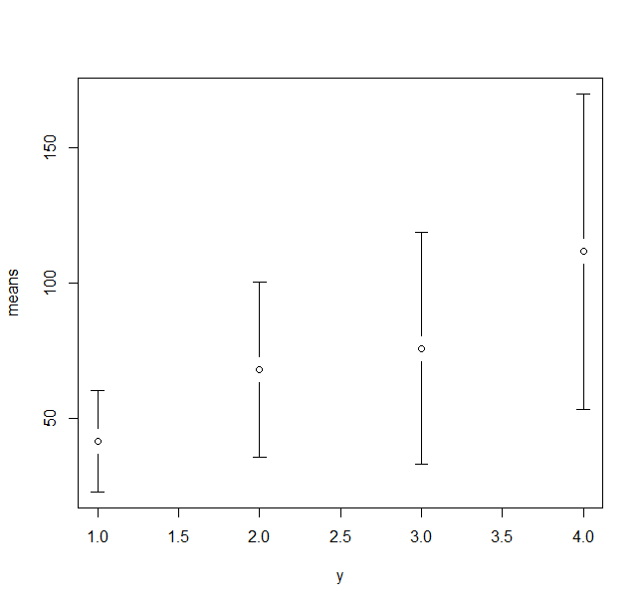
Example 1b: Same Groups: Larger within Group Variances
Salary in 1000s
Group 1
Group 2
Group 3
Group 4

Slide 20
ANOVA
Variable | Example 1a | Example 1b
SST | 1.87E+10 | 2.49E+10
SSE | 0.197E+10 | 5.93E+10
MST | 6.25E+09 | 8.31E+09
MSE | 0.06E+09 | 1.65E+09
F Statistic | 114.4 | 5.04
You need to know how to interpret F statistic for ANOVA.

Slide 21
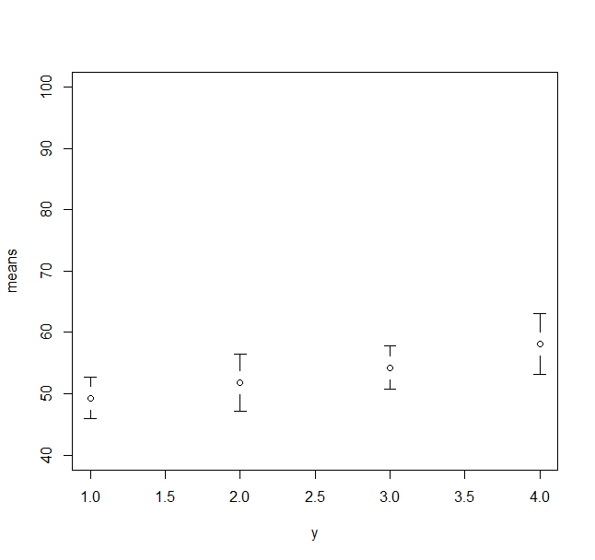
Example Ic: Smaller Between Group Variances
Salary in 1000s
Group 1
Group 2
Group 3
Group 4

Slide 22
ANOVA Table
Variable | Example 1a | Example 1b | Example 1c
SST | 1.87E+10 | 2.49E+10 | 0.2E+10
SSE | 0.2E+10 | 5.93E+10 | 0.3E+10
MST | 6.25E+09 | 8.31E+09 | 0.7E+09
MSE | 0.06E+09 | 1.65E+09 | 0.09E+09
F Statistic | 114.4 | 5.04 | 7.9
What happens to F?

Slide 23
More ways to use ANOVA.
Evaluating the consistency of an athlete or a team
The variability of speeds on a highway
The variability of repair costs of certain automobiles;
Etc.

Slide 24
ANOVA
ANOVA One factor — e.g. new testing method
ANOVA Two factors — e.g. new testing method and gender
Sample sizes
Post-Hoc tests
Least Significant Difference (LSD)
Tukey HSD’s test
Tukey Kramer
Brown-Forsythe

Slide 25
ANOVA Applications
Please work on the ANOVA applications from Week 6 Module

Slide 26
Chapter 14 and 15
Regressions

Slide 27
Simple Linear Regression
Introduction to Simple Linear Regressions
Ordinary Least Squares (OLS)
Hypothesis Testing

Slide 28
Why Linear Regression?
Linear regression attempts to model the relationship between two variables by fitting a linear equation to observed data.
When we talk about how “good” a model fits we are talking about comparing it to another model.

Slide 29
Our First Model
Assume that you are a statistics student ☺
You would like to develop a model that will allow you to make predictions about how many questions you will get correct on an exam.

Slide 30
Our First Model
You collect information from a random sample tests over the semester.
Descriptor
Variable
Test Number | Correct Answers
1 | 5
2 | 17
3 | 11
4 | 8
5 | 14
6 | 5
With only one variable how can you predict how many questions you will get correct in Test # 7?

Slide 31
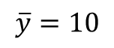
Predicting Test # 7
Test Number | Correct Answers
1 | 5
2 | 17
3 | 11
4 | 8
5 | 14
6 | 5
”best-fit” line
$$\overline{y}=10$$
With only one variable, and not other information, the best prediction for the next measurement is the mean of the sample
Itself. The variability in the number of correct answer can only be explained by the tests themselves.

Slide 32
Sum of Square Errors (SSE)
Test Number | Errors (Residual) | Errors² (Residual²)
1 | -5 | 25
2 | +7 | 49
3 | +1 | 1
4 | -2 | 4
5 | +4 | 16
6 | -5 | 25
= +12
-5
-2
Errors (Residuals)
-5
Sum of Square Errors (SSE) = 120
= -12
We only have the dependent variable to work with so it’s also:
Sum of Square Total (SST) = 120
SSE=SST

Slide 33
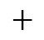
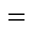
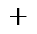
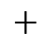
Sum of Squares
49
25
25
120
$$+$$
$$+$$
4
$$+$$
16
$$+$$
$$=$$
$$+$$
1
The goal of simple linear regression is to create a linear model that minimizes the sum of squares of errors (SSE)
If our regression model is significant, it will shrink the squares that were created without an independent variable.
When we introduce the independent variables we’ll have a new set of squares that should be smaller (reduce SSE).
The regression line will “fit” the data better and will minimize these squares. BUT it also comes with it’s own set of errors (residuals²) which we refer to as sum of squares regression.

Slide 34
Comparing the ”Fit” of the Model
49
When we conduct a simple linear regression with a dependent and independent variable. We will see good that data ”fits” when compared to this ”fit”.
16
1
25
4
25
-5
Sum of Square Errors (SST) = 120

Slide 35
Bivariate Relationships: Correlation vs. Covariance
Covariance: is a measure of how much two random variables vary together.
Similar to variance, but where variance tells you how a single variable varies, co variance tells you how two variables vary together.
Provides the direction of the linear relationship between two variables.
Correlation: a quantity measuring the extent of interdependence of variables.
Provides the direction and strength of the linear relationship between two variables.

Slide 36
Getting ready for Least Square Regression
Before attempting to fit a linear model to observed data, first determine whether or not there is a relationship between the variables of interest
Check the relationship visually.
Calculate the Correlation Coefficient
A valuable numerical measure of association between two variables is the correlation coefficient, which is a value between -1 and 1 indicating the strength of the association of the observed data for the two variables.

Slide 37
Correlation Coefficient: R

Slide 38
Correlation Caveats
Correlation is only applicable to linear relationships.

Slide 39

Correlation Caveats, cont.
Correlation does not imply causation.

Slide 40
Getting Ready for Our Model
Open Study Hours excel file in data folder
Check our relationship visually – scatter plot
Check our correlation (R) - Formula: CORREL

Slide 41
We‘re ready to get started with our model
We Bring in the Independent Variable – Study Hours
Lets look at the relationship visually: scatter plot
Study Hours | Correct Answers
34 | 5
108 | 17
64 | 11
88 | 8
99 | 14
51 | 5
“I Expect A Higher Number of Correct Answers With Higher Study Hours”

Slide 42
Least Squares Criterion
The least squares is a form of mathematical regression analysis that finds the line of best fit for a dataset, providing a visual demonstration of the relationship between the data points.

Slide 43
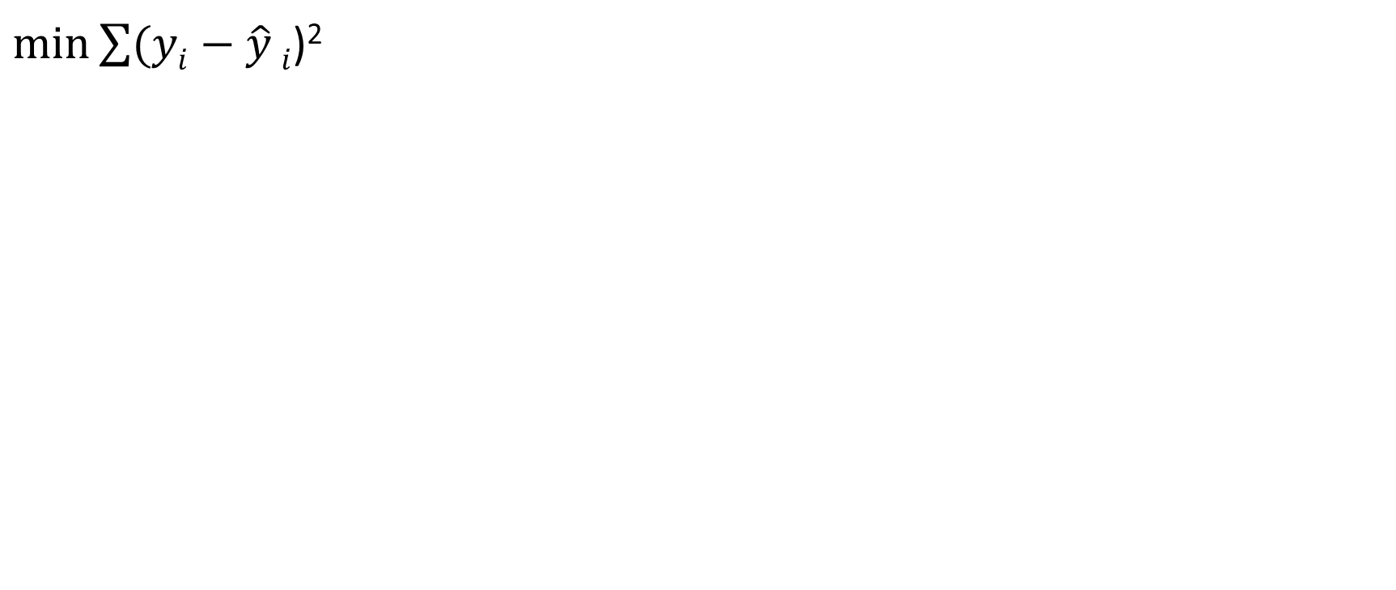
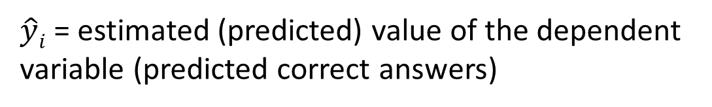
Least Squares Criterion
$\min{\sum{(yi−\hat{y}}}i$)²
Where:
$yi$= observed value of dependent variable (correct answers)
$\hat{y}i$ = estimated (predicted) value of the dependent variable (predicted correct answers)
Goal is to minimize the sum of squared differences between the observed values
of the dependent variable ($yi$) and the estimated value of the dependent variable ($\hat{y}i$)

Slide 44
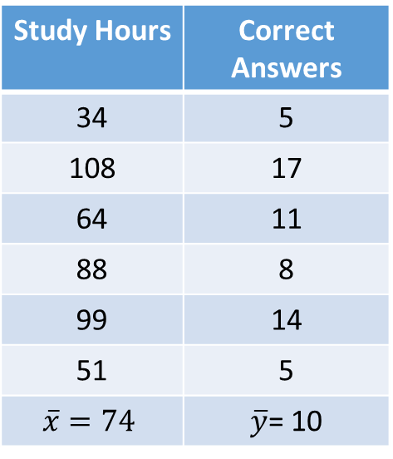
Scatter Plot
Study Hours | Correct Answers
34 | 5
108 | 17
64 | 11
88 | 8
99 | 14
51 | 5
$$\overline{x}=74$$ | $\overline{y}$= 10
Centroid
(74,10)
“Higher study hours will result in higher correct answers”

Slide 45
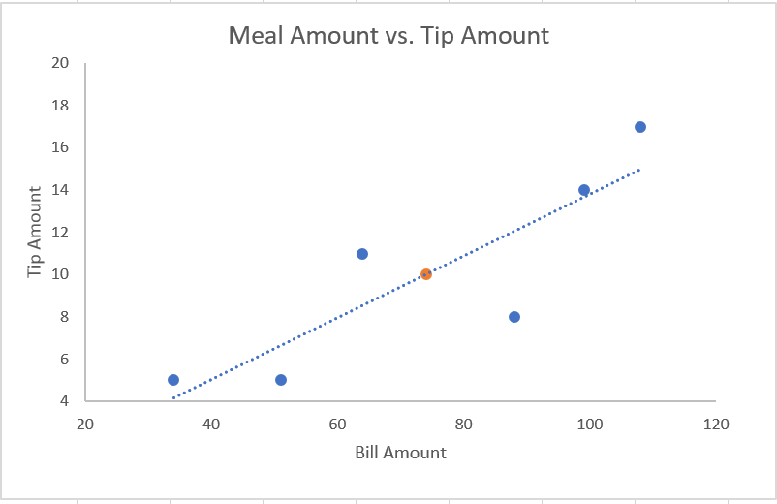
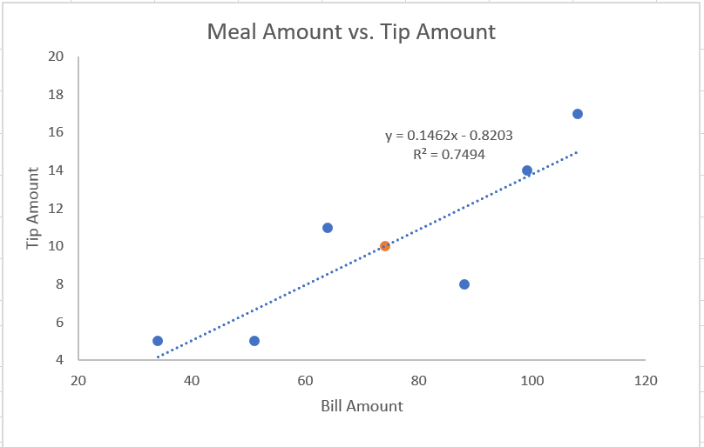
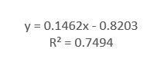
Simple Linear Regression (OLS)
Recall:
Sum of Square Total (SST) = 120
Study Hours and Correct Answers
SSE=30.075
Now:
Sum of Square Errors (SSE) = 30.075
4.1237
SST – SSE = SSR
.1201
Correct Answers
6.0688
One variable
Sum of Square due to Regression
16.3645
.7217
2.6762
Study Hours

Slide 46
Recap
When we conducted the regression, the SSE decreased from 120 to 30.075. That is, 30.075 of the sum of squares was explained or allocated to ERROR.
Where did the other 89.925 go?
The leftover is the sum of squares due to REGRESSION.
SST = SSR + SSE
120 = 89.25 + 30.075

Slide 47
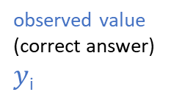
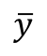
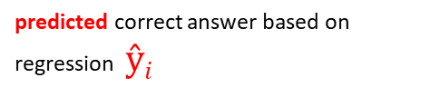
3 Squared Differences
Study Hours and Correct Answers
Bill Amount vs. Tip Amount
observed value (correct answer) $y$_{i}
predicted correct answer based on regression $ŷi$
Correct Answers
mean of dependent variable (correct answer only)
$$\overline{y}$$
Study Hours

Slide 48
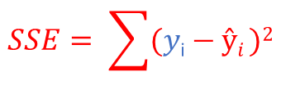
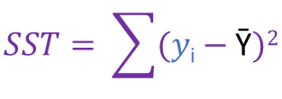
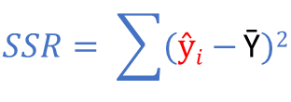
3 Squared Differences
Study Hours and Correct Answers
$$SSE= \sum{(y\text{i}−ŷi })2$$
$$SSR= \sum{(ŷi−}\text{Ȳ})2$$
$$SST= \sum{(y\text{i}−\text{Ȳ}})2$$
Correct Answers
Study Hours

Slide 49
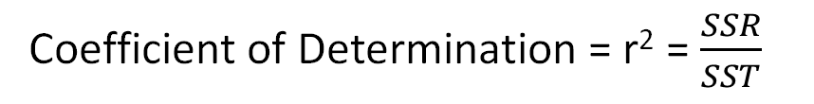
How well does our estimated regression “fit” our data?
Coefficient of Determination
If SSR is large, it is a greater component of SST (SSE is smaller). The coefficient of determination quantifies this ratio a percentage:
SST
SSR
SSE
Coefficient of Determination = r² = $\frac{SSR}{SST}$

Slide 50
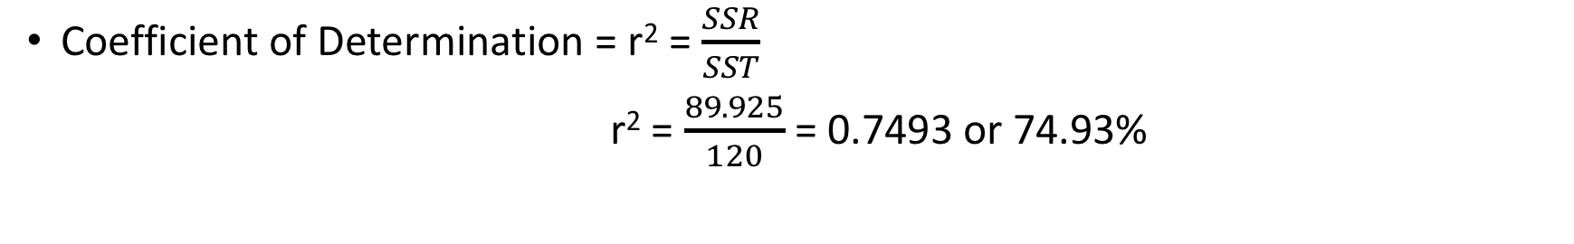
r² Interpretation
Coefficient of Determination = r² = $\frac{SSR}{SST}$
r² = $\frac{89.925}{120}$ = 0.7493 or 74.93%
We can conclude that 74.93% of the total sum of squares can be explained by using the estimated
regression equation to predict the correct answer number. Another way to say it: 74.9% of the variation in the
Score amount is explained by the relationship between the variables. The remaining 25.1% is due to other
factors (i.e. chance, sampling error, etc.)

Slide 51
Purpose of Regression
To figure out how much variation in the dependent variable (Y) can be explained by the variation in the independent variable (X).
In our correct score example – 74.9% of the variation in the scores is explained by the relationship between the variables.
The remaining 25.1% is due to other factors (i.e. chance, sampling error, etc.)

Slide 52
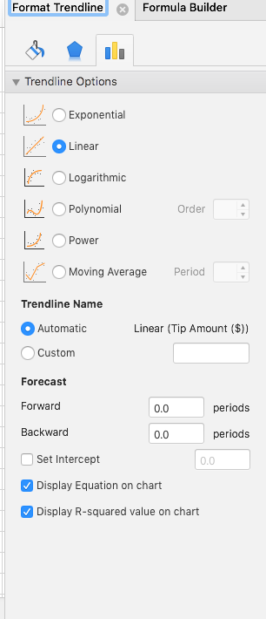
Regression in Excel
Plot data on scatter plot
Make sure dependent variable is always on Y-axis.
Chart Design
Add chart element
Trendline – Linear
More Trendline Options
Display equation on chart
Display R-Squared value on chart

Slide 53
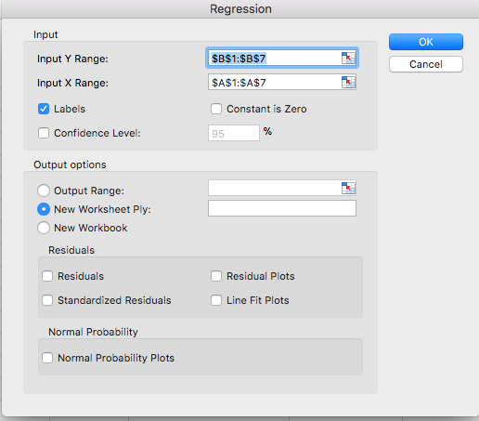
Regression in Excel – Data Analysis
Choose Regression in Data Analysis Toolbox

Slide 54
Simple Linear Regression (OLS)
Bill Amount vs. Tip Amount
Study Hours and Correct Answers
Correct Answers
Study Hours

Slide 55
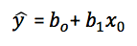
Interpreting our Equation
Recall: equation of a line
y = mx + b
Simple Linear Regression
slope
dependent variable
y-intercept
independent variable

Slide 56
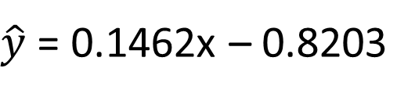
Interpreting our Equation
Slope Study Hours
$\hat{y}$ = 0.1462x – 0.8203
y-intercept
If study hours is 60 (x=60). How many correct answers can we expect to make? 7.95
$\hat{y}$ = 0.1462(60) – 0.8203 = 7.95 or approximately 8 correct questions

Slide 57
Interpreting our Equation
Slope Study Hours
$\hat{y}$ = 0.1462x – 0.8203
y-intercept
If X =0 we can expect a correct score number of -.8203 (?!)

Slide 58
Interpreting R²
Is a low R² “bad”?
Not necessarily. Some fields expect lower R²
Psychology
Sociology
Behavioral Economics
If R² is low but you have a statistically significant independent variable. You can still draw important conclusions about how changes in independent variables affect dependent variables
Humans are Hard to Predict!

Slide 59
Interpreting R²
Is a high R² “good”?
Not always
In particular, when looking at multiple linear regression. More variables can artificially inflate R².

Slide 60
Multiple Linear Regression
Multiple regression is an extension of simple linear regression
Linear regression
One-to-one relationship (study hours and score)
Multiple Regression
Many-to-one relationship (study hours and score, quality of instructor, how much caffeine you consumed, etc)

Slide 61
Multiple Linear Regression Considerations
Adding more independent variables (or predictors) to a multiple regression does not mean it’s better or offers better predictions.
It can actually be worse (overfitting the model).
The idea is to pick the best variable.
Unlike setting up linear regression, setting up a multiple linear regression requires more time
Correlation analysis
Tests for significance
Simple linear regressions

Slide 62
The Multiple Linear Regression Model
If there is more than one explanatory variable available, we can use multiple regression.
For example, we analyze how debt payments are influenced by income, but ignored the possible effect of unemployment.
Multiple regression allows us to explore how several variables influence the response variable.
Estimate the multiple linear regression model and interpret the coefficients.
LO 14.4

Slide 63
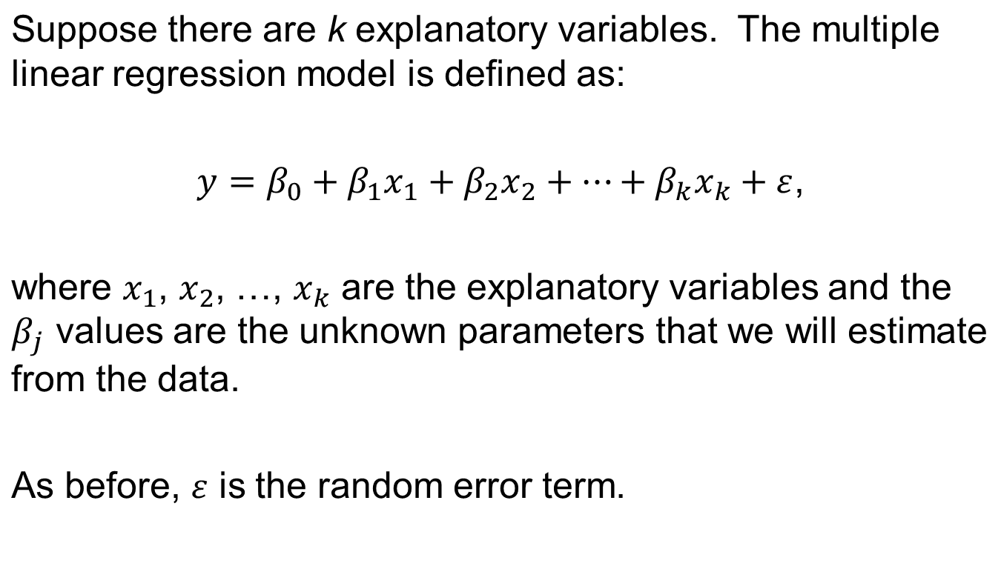

The Multiple Regression Model
LO 14.4

Slide 64
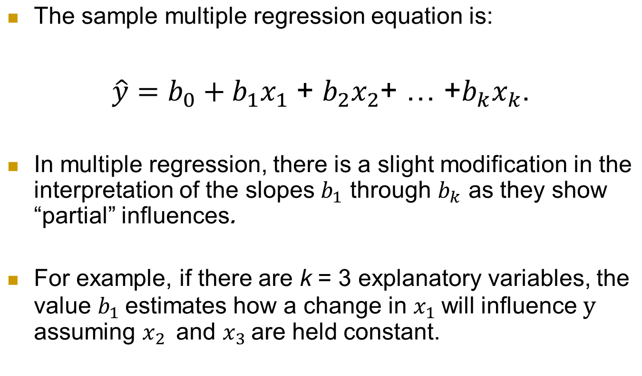
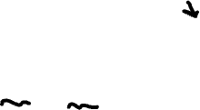
The Estimated Equation
LO 14.4

Slide 65
Debt Payments Adding a Second Predictor
In addition to income, the unemployment rate may also influence an area’s average debt payments.
Excel File Debt_Payments
Utilizing Excel, we can easily add the additional explanatory variable by choosing Data > Data Analysis > Regression as before, but now select both income and the unemployment rate data for Input X Range.
Excel requires that the explanatory variables be in contiguous columns.
LO 14.4

Slide 66
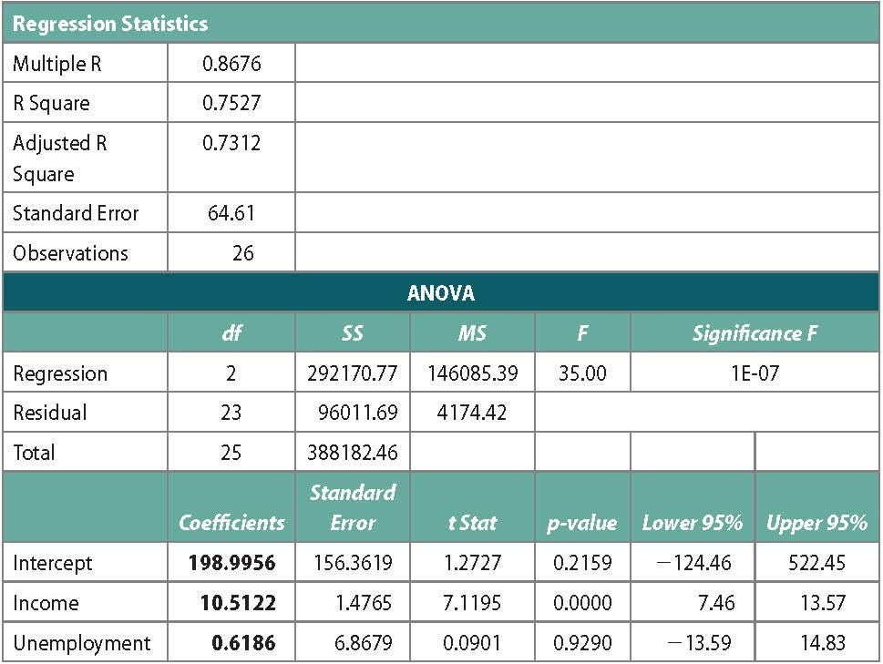
Debt Payment: Expanded Computer Output
The output reflects the additional coefficient estimate for unemployment. The other coefficients also change slightly.
LO 14.4

Slide 67
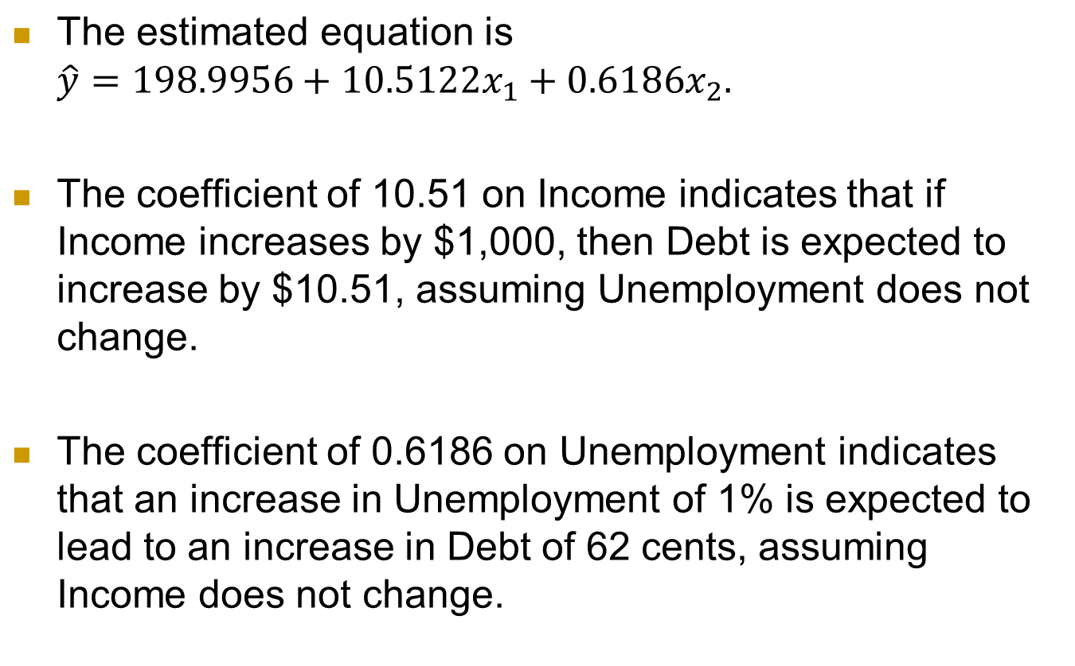
Debt Payment Interpretation of Slopes
LO 14.4

Slide 68
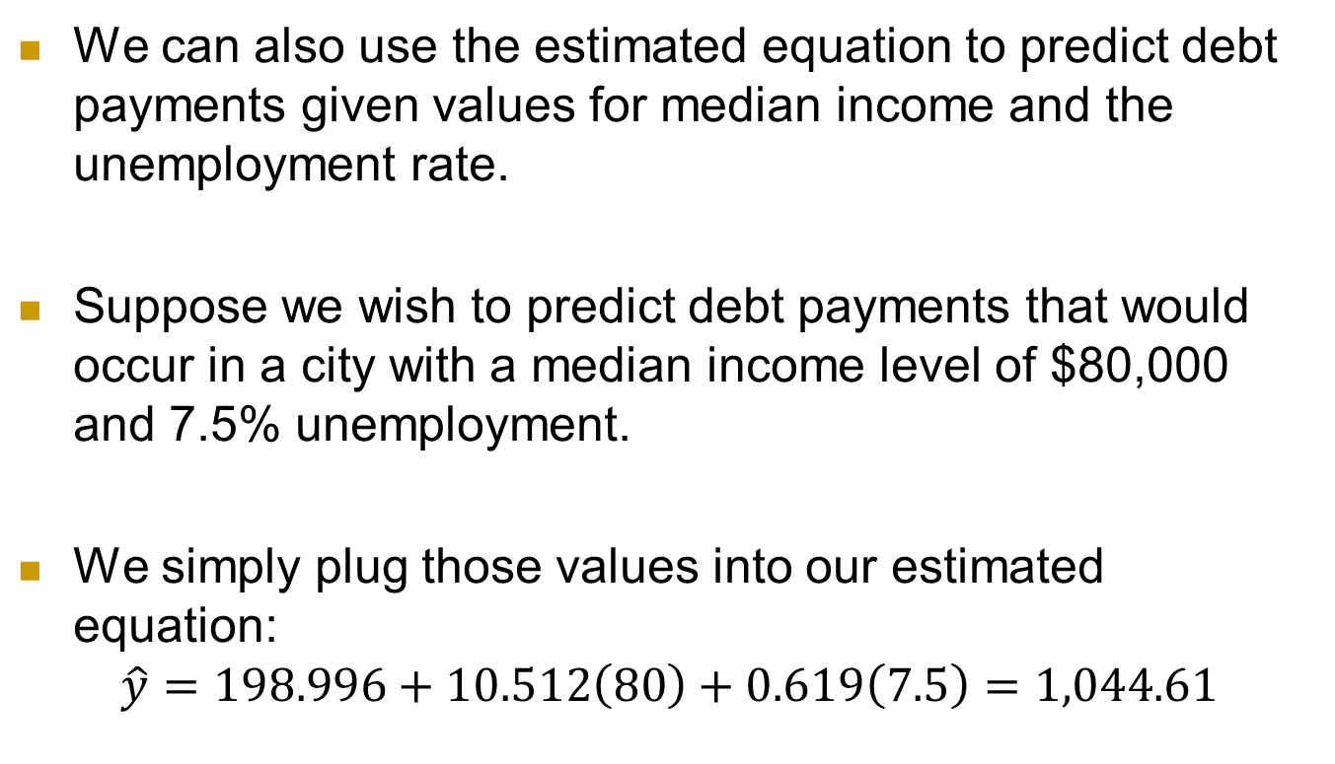
Debt Payment Predicting the Debt Level
LO 14.4

Slide 69
The Adjusted R²
More explanatory variables always result in a higher R².
But some of these variables may be unimportant and should not be in the model.
The Adjusted R² tries to balance the raw explanatory power against the desire to include only important predictors.
LO 14.7

Slide 70
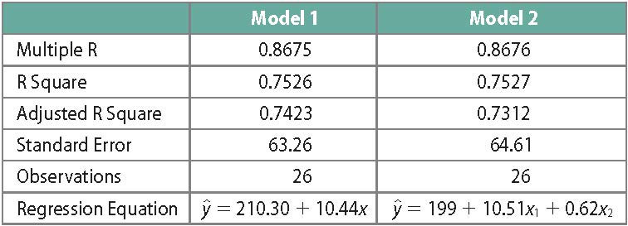
Model Comparison
Comparing a simple linear regression of income and debt (Model 1) with the multiple linear regression model (Model 2):
Even though the R² is a bit higher in the multiple regression, the adjusted R² is lower and standard error higher, implying we are better off without the second predictor.
LO 14.7

Slide 71
Time Series Forecasting
The first step in time series forecasting is usually determining the model you will use. Model will depend on the components of the data.
Trend Long-run growth or decline
Cycle Long-run up and down fluctuation around the trend level
Seasonal Regular periodic up and down movements that repeat within the calendar year
Irregular Erratic very short-run movements that follow no regular pattern

Slide 72
Time Series Exhibiting Trend, Seasonal, and Cyclical Components
Figure 17.1

Slide 73
The No Trend Model
When there is no trend, the least squares point estimate b₀ of β₀ is just the average y value
y_{t} = β₀ + ε_{t}
That is, we have a horizontal line that crosses the y axis at its average value

Slide 74
A Trend Model
When sales increase (or decrease) over time, we have a trend
Oftentimes, that trend is linear in nature
Linear trend is modeled using regression
Sales is the dependent variable
Time is the independent variable
Weeks, months, quarters, years

Slide 75
Multiplicative Decomposition
We can use the multiplicative decomposition method to decompose a time series into its components:
Trend
Seasonal
Cyclical
Irregular

Slide 76
The Simple Moving Average
The moving average (MA) move us towards using multiple sequential periods to generate forecasts.
Very flexible:
Cumulative moving average (CMA)
Simple moving average (SMA)
Weighted moving average (WMA)
Exponential moving average (EMA)
Has the effect of smoothing data

Slide 77
Benefits of Moving Averages
Transparent process that is easy to understand and calculate.
Flexible and customizable
We can create a moving average of the moving averages :D

Slide 78
Downside of Moving Averages
Shorter data sets (time windows) can let extreme values dominate the model and minimize any smoothing.
Longer data sets (time windows) can dampen the moving average too much.
It can be a challenge to find the balance.

Slide 79
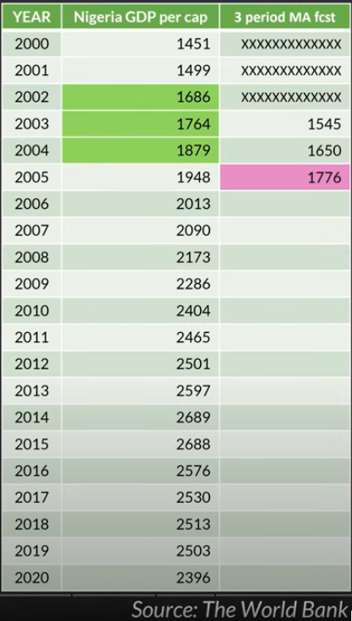
Moving Average Example

Slide 80
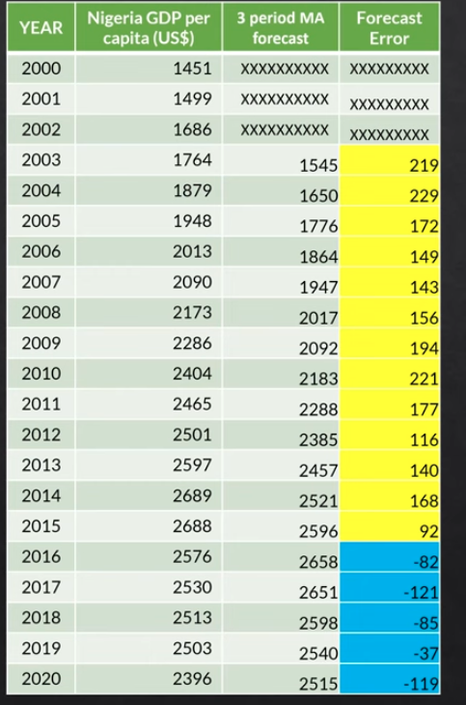
Analyzing Errors

Slide 81
Importance of Errors
Comparing to other modeling techniques
Can help to select and interpret other forecasting techniques
Errors create their own time series that can be key information

